Slide 1
SYSTEM MODELS FOR DISTRIBUTED AND CLOUD COMPUTING

Slide 2
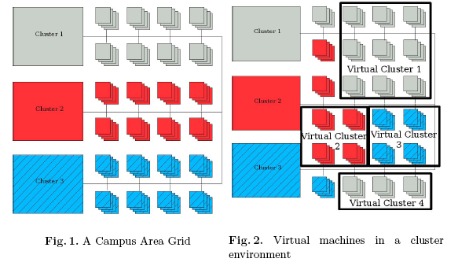
Concept of Virtual Clusters
(Source: W. Emeneker, et et al, “Dynamic Virtual Clustering with Xen and Moab, ISPA 2006, Springer-Verlag LNCS 4331, 2006, pp. 440-451)
Copyright © 2012, Elsevier Inc. All rights reserved.

Slide 3
Clusters of Cooperative Computers
A computing cluster consists of interconnected stand-alone computers which work cooperatively as a single integrated computing resource.

Slide 4
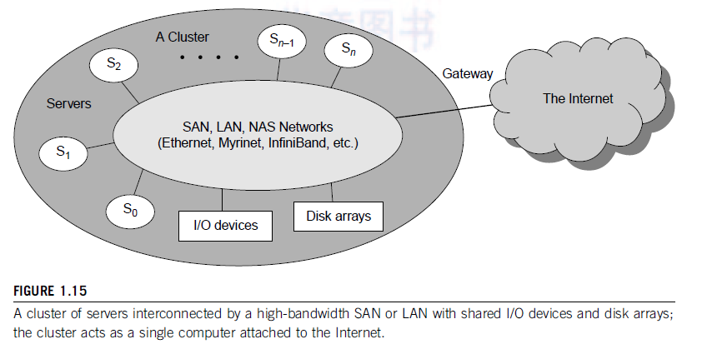
A Typical Cluster Architecture

Slide 5
Above shows the architecture of a typical server cluster built around a low-latency, highbandwidth interconnection network.
This network can be as simple as a SAN (e.g., Myrinet) or a LAN (e.g., Ethernet).
To build a larger cluster with more nodes, the interconnection network can be built with multiple levels of Gigabit Ethernet, Myrinet, or InfiniBand switches.
Through hierarchical construction using a SAN, LAN, or WAN, one can build scalable clusters with an increasing number of nodes.
The cluster is connected to the Internet via a virtual private network (VPN) gateway. The gateway IP address locates the cluster.

Slide 6
Single-System Image
an ideal cluster should merge multiple system images into a single-system image (SSI).
Cluster designers desire a cluster operating system or some middleware to support SSI at various levels, including the sharing of CPUs, memory, and I/O across all cluster nodes.
An SSI is an illusion created by software or hardware that presents a collection of resources as one integrated, powerful resource.
SSI makes the cluster appear like a single machine to the user.

Slide 7
Hardware, Software, and Middleware Support
building blocks are computer nodes (PCs, workstations, servers, or SMP), special communication software such as PVM or MPI, and a network interface card in each computer node. Most clusters run under the Linux OS.
The computer nodes are interconnected by a high-bandwidth network (such as Gigabit Ethernet, Myrinet, InfiniBand, etc.).
Special cluster middleware supports are needed to create SSI or high availability (HA).
Both sequential and parallel applications can run on the cluster, and special parallel environments are needed to facilitate use of the cluster resources.
DSM-Virtualization(on demand)
Parallel Virtual Machine (PVM) is a software tool for parallel networking of computers.

Slide 8
Major Cluster Design Issues
Without middleware, cluster nodes cannot work together effectively to achieve cooperative computing.
The software environments and applications must rely on the middleware to achieve high performance.
The cluster benefits come from scalable performance, efficient message passing, high system availability, seamless fault tolerance, and cluster-wide job management.

Slide 9
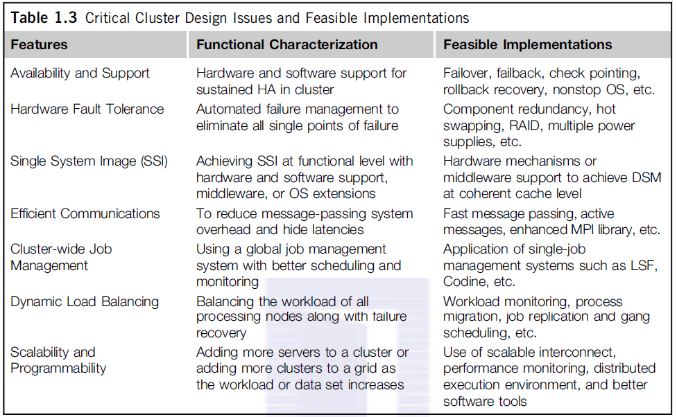
*Load Sharing Facility

Slide 10
Grid Computing Infrastructures
Internet services such as the Telnet command enables a local computer to connect to a remote computer.
A web service such as HTTP enables remote access of remote web pages.
Grid computing is envisioned to allow close interaction among applications running on distant computers simultaneously.

Slide 11
Grid computing is a form of distributed computing whereby a "super and virtual computer" is composed of a cluster of networked, loosely coupled computers, acting in concern to perform very large tasks.
Grid computing (Foster and Kesselman, 1999) is a growing technology that facilitates the executions of large-scale resource intensive applications on geographically distributed computing resources.
Facilitates flexible, secure, coordinated large scale resource sharing among dynamic collections of individuals, institutions, and resource
Enable communities (“virtual organizations”) to share geographically distributed resources as they pursue common goals

Slide 12
Criteria for a Grid:
Coordinates resources that are not subject to centralized control.
Uses standard, open, general-purpose protocols and interfaces.
Delivers nontrivial/ significant qualities of service.
Benefits
Exploit Underutilized resources
Resource load Balancing
Virtualize resources across an enterprise
Data Grids, Compute Grids
Enable collaboration for virtual organizations

Slide 13
Grid Applications
Data and computationally intensive applications:
This technology has been applied to computationally-intensive scientific, mathematical, and academic problems like drug discovery, economic forecasting, seismic analysis back office data processing in support of e-commerce
A chemist may utilize hundreds of processors to screen
thousands of compounds per hour.
Teams of engineers worldwide pool resources to analyze
terabytes of structural data.
Meteorologists seek to visualize and analyze petabytes of
climate data with enormous computational demands.
Resource sharing
Computers, storage, sensors, networks, …
Sharing always conditional: issues of trust, policy, negotiation, payment, …
Coordinated problem solving
distributed data analysis, computation, collaboration, …

Slide 14
Grid Topologies
• Intragrid
– Local grid within an organization
– Trust based on personal contracts
• Extragrid
– Resources of a consortium of organizations
connected through a (Virtual) Private Network
– Trust based on Business to Business contracts
• Intergrid
– Global sharing of resources through the internet
– Trust based on certification

Slide 15
Computational Grid
“A computational grid is a hardware and software infrastructure that provides dependable, consistent, pervasive, and inexpensive access to high-end computational capabilities.”
”The Grid: Blueprint for a New Computing Infrastructure”, Kesselman & Foster
Example : Science Grid (US Department of Energy)

Slide 16
Data Grid
A data grid is a grid computing system that deals with data — the controlled sharing and management of large amounts of distributed data.
Data Grid is the storage component of a grid environment. Scientific and engineering applications require access to large amounts of data, and often this data is widely distributed.
A data grid provides seamless access to the local or remote data required to complete compute intensive calculations.
Example :
Biomedical informatics Research Network (BIRN),
the Southern California earthquake Center (SCEC).

Slide 18
Methods of Grid Computing
Distributed Supercomputing
High-Throughput Computing
On-Demand Computing
Data-Intensive Computing
Collaborative Computing
Logistical Networking

Slide 19
Distributed Supercomputing
Combining multiple high-capacity resources on a computational grid into a single, virtual distributed supercomputer.
Tackle problems that cannot be solved on a single system.
Notes:
19

Slide 20
High-Throughput Computing
Uses the grid to schedule large numbers of loosely coupled or independent tasks, with the goal of putting unused processor cycles to work.
On-Demand Computing
Uses grid capabilities to meet short-term requirements for resources that are not locally accessible.
Models real-time computing demands.
Notes:
20

Slide 21
Collaborative Computing
Concerned primarily with enabling and enhancing human-to-human interactions.
Applications are often structured in terms of a virtual shared space.
Data-Intensive Computing
The focus is on synthesizing new information from data that is maintained in geographically distributed repositories, digital libraries, and databases.
Particularly useful for distributed data mining.
Notes:
21

Slide 22
Logistical Networking
Logistical networks focus on exposing storage resources inside networks by optimizing the global scheduling of data transport, and data storage.
Contrasts with traditional networking, which does not explicitly model storage resources in the network.
high-level services for Grid applications called "logistical" because of the analogy /similarity it bears with the systems of warehouses, depots, and distribution channels.
Notes:
22

Slide 23
P2P Computing vs Grid Computing
Differ in Target Communities
Grid system deals with more complex, more powerful, more diverse and highly interconnected set of resources than P2P.
VO

Slide 24
A typical view of Grid environment
Grid Information Service system collects the details of the available Grid resources and passes the information to the resource broker.
Grid Information Service
Details of Grid resources
1
2
Computational jobs
4
Grid application
3
Processed jobs
Computation result
User
Resource Broker
A User sends computation or data intensive application to Global Grids in order to speed up the execution of the application.
A Resource Broker distribute the jobs in an application to the Grid resources based on user’s QoS requirements and details of available Grid resources for further executions.
Grid Resources
Grid Resources (Cluster, PC, Supercomputer, database, instruments, etc.) in the Global Grid execute the user jobs.

Slide 25
Grid Middleware
Grids are typically managed by grid ware - a special type of middleware that enable
sharing and manage grid components based on user requirements and resource attributes (e.g., capacity, performance)
Software that connects other software components or applications to provide the following functions:
Run applications on suitable available resources
– Brokering, Scheduling
Provide uniform, high-level access to resources
– Semantic interfaces
– Web Services, Service Oriented Architectures
Address inter-domain issues of security, policy, etc.
– Federated / united / Associated Identities
Provide application-level status
monitoring and control

Slide 26
Middleware
Globus –chicago Univ
Condor – Wisconsin Univ – High throughput computing
Legion – Virginia Univ – virtual workspaces- collaborative computing
IBP – Internet back pane – Tennesse Univ – logistical networking
NetSolve – solving scientific problems in heterogeneous env – high throughput & data intensive
Notes:
26

Slide 28
Some of the Major Grid Projects
Name | URL/Sponsor | Focus
EuroGrid, Grid Interoperability (GRIP) | eurogrid.org European Union | Create tech for remote access to super comp resources & simulation codes; in GRIP, integrate with Globus Toolkit™
Fusion Collaboratory | fusiongrid.org DOE Off. Science | Create a national computational collaboratory for fusion research
Globus Project™ | globus.org DARPA, DOE, NSF, NASA, Msoft | Research on Grid technologies; development and support of Globus Toolkit™; application and deployment
GridLab | gridlab.org European Union | Grid technologies and applications
GridPP | gridpp.ac.uk U.K. eScience | Create & apply an operational grid within the U.K. for particle physics research
Grid Research Integration Dev. & Support Center | grids-center.org NSF | Integration, deployment, support of the NSF Middleware Infrastructure for research & education

Slide 29
Peer-to-Peer Network Families
a P2P network is client-oriented instead of server-oriented.
No central coordination or central database is needed.
In other words, no peer machine has a global view of the entire P2P system.
Figure shows the architecture of a P2P network at two abstraction levels.
Initially, the peers are totally unrelated. Each peer machine joins or leaves the P2P network voluntarily.
Only the participating peers form the physical network at any time. Unlike the cluster or grid, a P2P network does not use a dedicated interconnection network.
The physical network is simply an ad hoc network formed at various Internet domains randomly using the TCP/IP and NAI protocols.
Thus, the physical network varies in size and topology dynamically due to the free membership in the P2P network.
Network Access Identifier (NAI) is a standard way of identifying users who request access to a network.

Slide 31
There are two types of overlay networks: unstructured and structured.
An unstructured overlay network is characterized by a random graph.
There is no fixed route to send messages or files among the nodes.
Often, flooding is applied to send a query to all nodes in an unstructured overlay, thus resulting in heavy network traffic and nondeterministic search results.
Structured overlay networks follow certain connectivity topology and rules for inserting and removing nodes (peer IDs) from the overlay graph.
Routing mechanisms are developed to take advantage of the structured overlays.

Slide 33
Challenges – P2P
P2P computing faces three types of heterogeneity problems in hardware, software, and network requirements.
There are too many hardware models and architectures to select from; incompatibility exists between software and the OS; and different network connections and protocols make it too complex to apply in real applications
Fault tolerance, failure management, and load balancing are other important issues in using overlay networks.

Slide 34
Lack of trust among peers poses another problem; Peers are strangers to one another.
Security, privacy, and copyright violations are major worries by those in the industry in terms of applying P2P technology in business applications
the system is not centralized, so managing it is difficult.
In addition, the system lacks security. Anyone can log on to the system and cause damage or abuse.
Further, all client computers connected to a P2P network cannot be considered reliable or virus-free.
In summary, P2P networks are reliable for a small number of peer nodes.

Slide 35
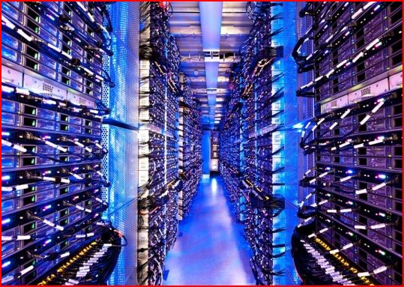

The Cloud
Historical roots in today’s Internet apps
Search, email, social networks
File storage (Live Mesh, Mobile Me, Flicker, …)
A cloud infrastructure provides a framework to manage scalable, reliable, on-demand access to applications
A cloud is the “invisible” backend to many of our mobile applications
A model of computation and data storage based on “pay as you go” access to “unlimited” remote data center capabilities
Copyright © 2012, Elsevier Inc. All rights reserved.

Slide 36
Basic Concept of Internet Clouds

Slide 37
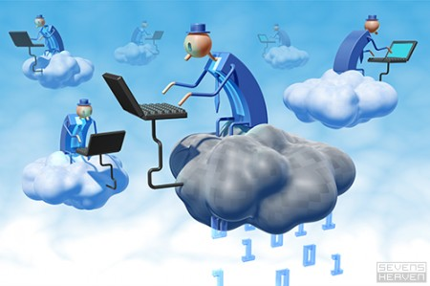
The Next Revolution in IT Cloud Computing
Classical Computing
Buy & Own
Hardware, System Software, Applications often to meet peak needs.
Install, Configure, Test, Verify, Evaluate
Manage
..
Finally, use it
$$$$....$(High CapEx)
Cloud Computing
Subscribe
Use
$ - pay for what you use, based on QoS
Every 18 months?
(Courtesy of Raj Buyya, 2012)
Copyright © 2012, Elsevier Inc. All rights reserved.

Slide 39
The following list highlights eight reasons to adapt the cloud for upgraded Internet applications and web services:
1. Desired location in areas with protected space and higher energy efficiency
2. Sharing of peak-load capacity among a large pool of users, improving overall utilization
3. Separation of infrastructure maintenance duties from domain-specific application development
4. Significant reduction in cloud computing cost, compared with traditional computing paradigms
5. Cloud computing programming and application development
6. Service and data discovery and content/service distribution
7. Privacy, security, copyright, and reliability issues
8. Service agreements, business models, and pricing policies

Slide 40
Cloud Computing Challenges: Dealing with too many issues (Courtesy of R. Buyya)
Pricing
Scalability
Virtualization
Resource Metering
Reliability
QoS
Billing
Service Level
Agreements
Energy Efficiency
Provisioning
on Demand
Utility & Risk Management
Security
Legal & Regulatory
Privacy
Software Eng. Complexity
Trust
Programming Env. & Application Dev.

